Slide 1
A Novel Method for Offensive Data Collection and Performance Analysis for Colorado State University Softball
Caroline Thomas
HONR 499

Slide 2

Overview
Created an app using R Shiny to collect data during batting practice and an R Markdown report to assess the performance of players
Goal: assess the coachability of players i.e. how well do they execute their given game plan
Need to collect data regarding the situation and game plan are as well as the outcome of each pitch and whether the player did their job (win/loss)

Slide 3
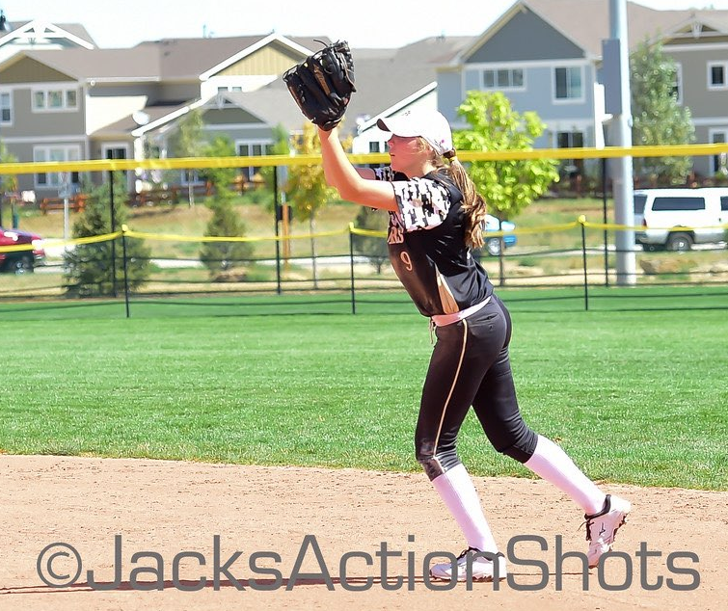
Interest
Played competitive softball for 11 years
Statistics!
Experience in sports analytics

Slide 4
Motivation
Goal: assess the coachability of players i.e. how well do they execute their given game plan
Need to collect data regarding the situation and game plan are as well as the outcome of each pitch and whether the player did their job (win/loss)
Currently state of data collection:
RightView Pro during games
Error prone, tagged by manager
Does not include info about what players are supposed to be doing
Only during games so small sample size and not all players have equal opportunities
Paper-and-pencil data collection

Slide 5
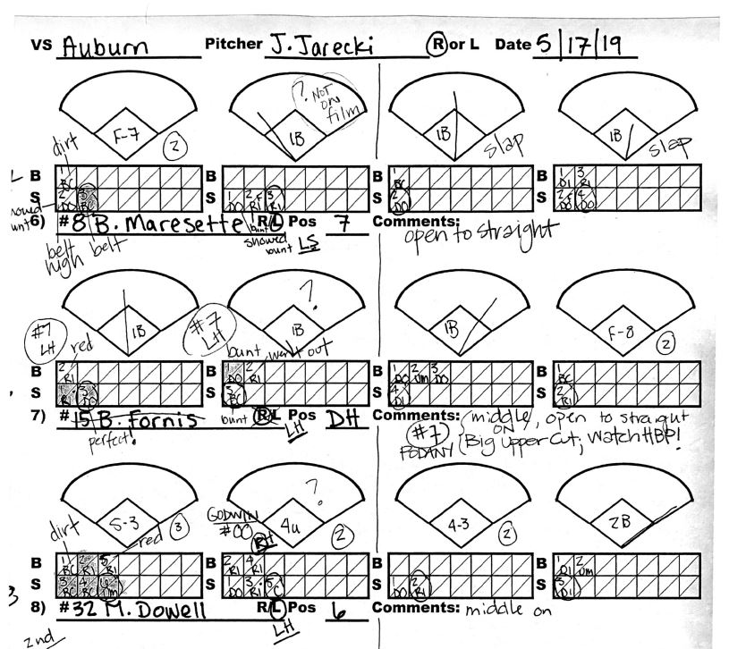
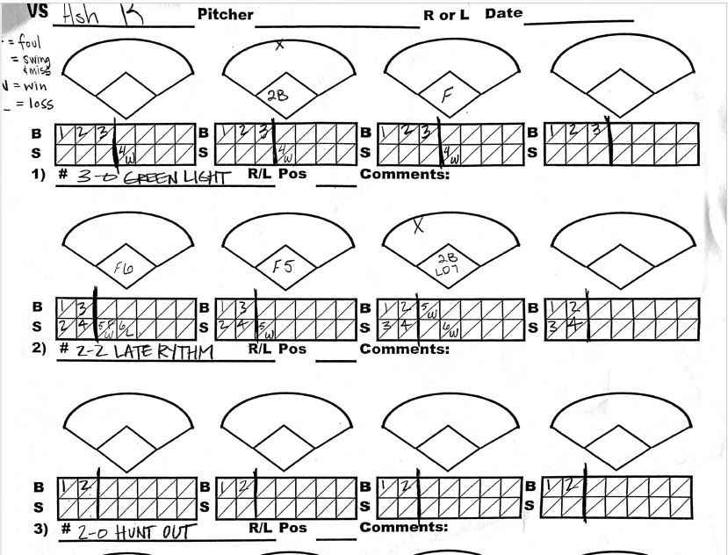
Paper-and-Pencil Data Collection

Slide 6
App and Analysis Demo
App is accessible through url: https://caroline-thomas.shinyapps.io/softballapp/
Or can download R script from GitHub and run in R Studio https://github.com/thomascr9/Honors-Thesis
R Markdown file for analysis can be found on GitHub
Tutorials for the app and analysis can be found on YouTube: https://www.youtube.com/playlist?list=PLonGs-oj4UGBcBxyflNtDNxNG9d725Okb

Slide 7

Reflection
Learning outcomes
Technical skills
R Shiny
tidyverse and ggplot2
The “process” of answering a question
Life skills
Communication
Time management
Problem solving
Obstacles
R Shiny troubleshooting
Googling
Dr. Brooke Anderson, Ben Prytherch
R Studio’s Shiny tutorials

Slide 8

Future Directions
Continue developing the analysis report according to needs of Coach Fisher
Including analysis with outcomes
Automate report even further
Work out glitches in app
Data download problem with multiple checkboxes
Filtering data & pie chart
Test the app at real practices to improve efficiency and ease of use
Game version

Slide 9
Thank you for listening!
Questions?

